Slide 1
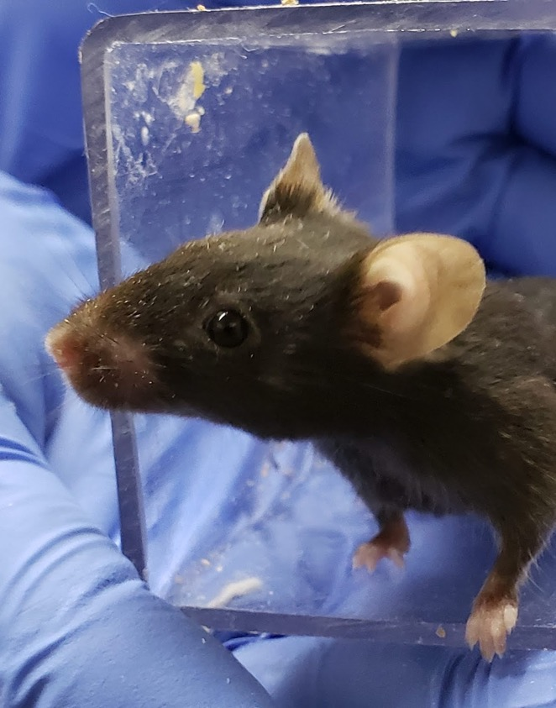
WHY & HOW: Refined methods of picking up mice
The North American 3Rs Collaborative
Notes:
Today I’m excited to talk to you about refining mouse handling with non-aversive handling. We will mostly talk about the the why, but also a bit about the how

Slide 2
Traditionally, mice are picked up by the base of the tail to be moved for cage change, exams, or procedures.
Notes:
Currently, we use standard accepted methods to pick up mice such as by the tail or forceps. In the past these have been good, they’ve worked for us, and it’s the best option we have.

Slide 3
Now, evidence shows that picking mice up with tunnels or cupped hands is an important, impactful
3Rs refinement.
Notes:
But now, there’s a new way to pick up mice that is even better. Evidence shows that picking mice up tunnels or cupped hands is an important, impactful, 3Rs refinement

Slide 4
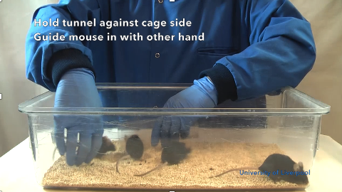
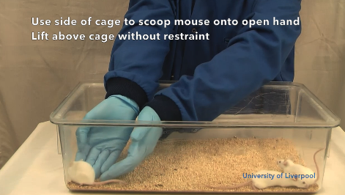
These videos from University of Liverpool show how to use a tunnel or cupped hands to pick up mice prior to conducting normal procedures.(e.g., restraint, injection).
https://vimeo.com/236716093
https://vimeo.com/236715432
Hurst & West 2010
Thank you to University of Liverpool & NC3Rs for making these available for staff training https://www.nc3rs.org.uk/video-clips

Slide 5
Strong evidence indicates that refined handling is advantageous.
(>15 publications across 10 years from independent labs)
Notes:
Over 15 publications from independent labs

Slide 6
Refined handling improves mouse welfare.
Reduced anxiety as measured by elevated plus maze, social novelty test, open field test, and light-dark box test (shown in 10 papers including Hurst & West 2010)
Reduced depressive-like behavior as measured by sucrose reward, resilience to negative events (Clarkson et al. 2018, 2020), forced swim test and burrowing test (Sensini et al. 2020)
Reduced chronic stress as measured by adrenal gland size (Clarkson et al. 2020)

Slide 7
Refined handling improves scientific outcomes & breeding
Increased test reliability (Hurst & West, 2017)
Improved physiological parameters such as improving glucose tolerance & reducing blood glucose & corticosterone (Ghosal et al. 2015; Ono et al. 2016)
Increased voluntary interaction with the handler (shown in 10 papers including Hurst & West 2010)
Improved breeding as measured by larger pups (0.75g), more pups born (1), weaned (1.5 ), and longer breeding productive lifespan (20%; Hull et al., In Preparation).

Slide 8
Refined handling is generalizable across
Strain
Sex
Handlers
Cage Types
Laboratories
Light cycle

Slide 9
Institutions report improved identification of health issues via fast, effortless visualization through the tunnel.

Slide 10
Handlers report less aggression, fewer bites, & less cage escapes.
“I teach Mouse 101. Often, we would have mouse bites to brand new mouse handlers. This was stressful to everyone involved.
Since moving to tunnel trained mice… we have not had any mouse bites to brand new mouse handlers. …This is great welfare for the mice. And great for the handlers for confidence and learning.”

Slide 11
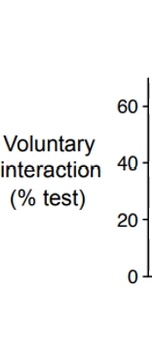
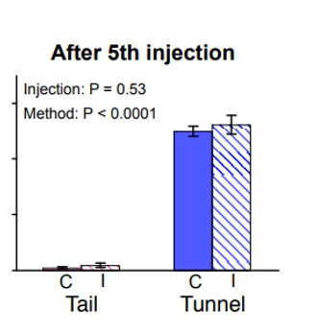
Tail restraint
Refined handling is beneficial even when combined with standard procedures.
(Gouveia & Hurst 2019, Sci Reports)
Blood Draws
Scruffing
Anesthesia
Injections
(Hurst & West 2010; Roughan & Sevenoaks 2018; Gouveia & Hurst 2019; Henderson et al., 2020; Nakamura & Suzuki, 2018)
Oral Gavage

Slide 12
Once staff are trained, refined handling takes no more time & is beneficial even if only done at cage change.
(Gouveia & Hurst, 2019)

Slide 13
Takeaway: refined handling is advantageous to
animals, science, & people.
Improves animal
welfare
Increases scientific quality
Improves ease of handling
Increase job satisfaction

Slide 14
Refined handling is practical, even for large institutions.
Non-aversive handling has been implemented exclusively by >60% of UK institutions
At least 2 large (>20,000 mouse cage) facilities in the USA have made the switch.
They report it takes no more time after proper training is implemented.
People say once they’ve switched that they’d never go back.

Slide 15
How to switch to non-aversive handling?

Slide 16
Steps to implementation
Secure support from high-level management and oversight bodies (e.g., IACUC).
Try non-aversive handling yourself and identify champions from, husbandry, veterinary, and scientific staff to educate others on how to best implement into existing practices.
Order supplies and create training resources about evidence and methods – bringing in external experts may be helpful to provide presentations, training, & personal consultation.
Roll out tunnel handling in stages (e.g., beginning with one rack or room) while collecting feedback and addressing any concerns.

Slide 17
Common Concerns --> Solutions
Contamination from tunnels --> Cupping only
Mice too large for tunnels --> Cupping
Cage leaks from tunnel --> Reminders to place tunnel parallel along the edge (see more solutions on the NC3Rs FAQ Page)
Too expensive --> Cupping & transition to tunnel method one area at a time
Will take too long to change cages --> Once handlers are trained, takes no extra time (Gouveia & Hurst 2019)

Slide 18
Evidence
The takeaway: refined handling has
Impact
Practicality

Slide 19
For more details & references visit na3rsc.org/picking-up-mice &
nc3rs.org.uk/how-to-pick-up-a-mouse
Notes:
For more details NA3RsC has a web page on the topic

Slide 20
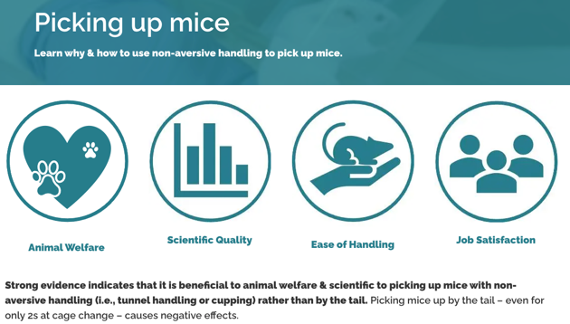
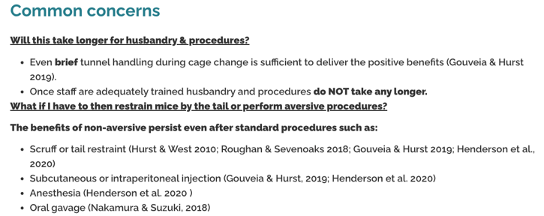
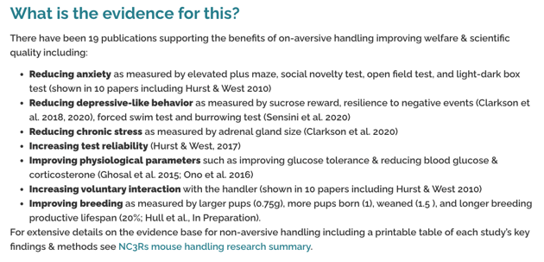
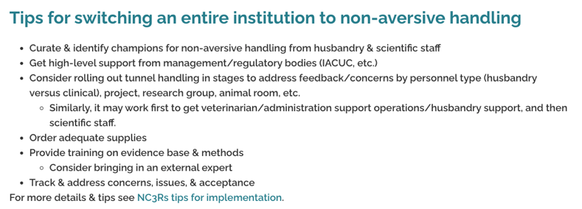
NA3RsC’s resource page gives a high-level overview.
Notes:
Goes through the
reasons to consider switching
Options for switching
Common concerns > further research > etc.
26 references

Slide 21
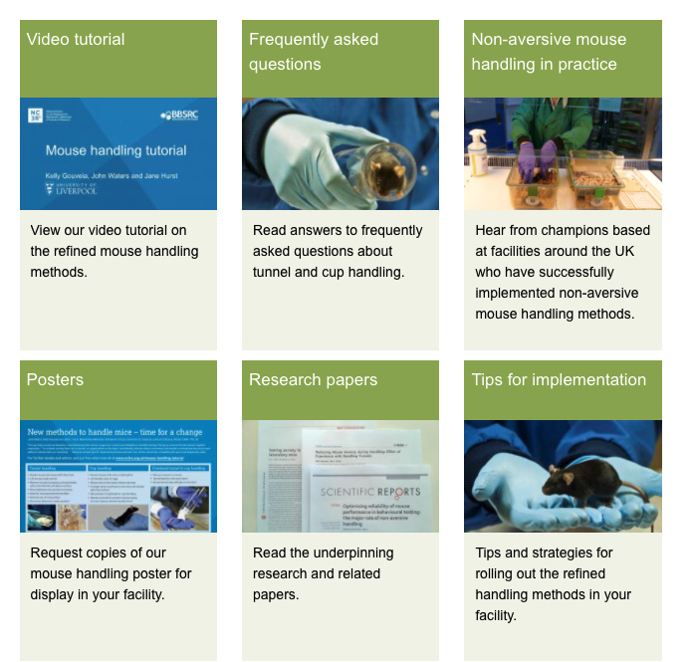
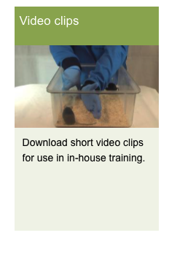
Nc3Rs’ resource page has in depth information.

Slide 22
Thank you to NA3RsC’s refinement initiative for this presentation & their work in this area.
Megan LaFollette, NA3RsC
Mark Prescott, NC3Rs
Donna Goldsteen, AstraZeneca
Elizabeth Nunamaker, Charles River Laboratories
Sarah Thurston, Charles River Laboratories
Sally Thompson-Iritani, University of Washington
Christine Buckmaster, Stanford
Coralie Zegre Cannon, BD
Meaghan Loy, Scientist.com
Jennifer McMillan, Emory
Penny Reynolds, University of Florida
Sally Robinson, AstraZeneca
Notes:
And with that I’d like to thank the NA3RsC rodent health monitoring initiative for providing this paper.

